Slide 1
NodeJS
Mongoose haladó lekérdezések

Slide 2
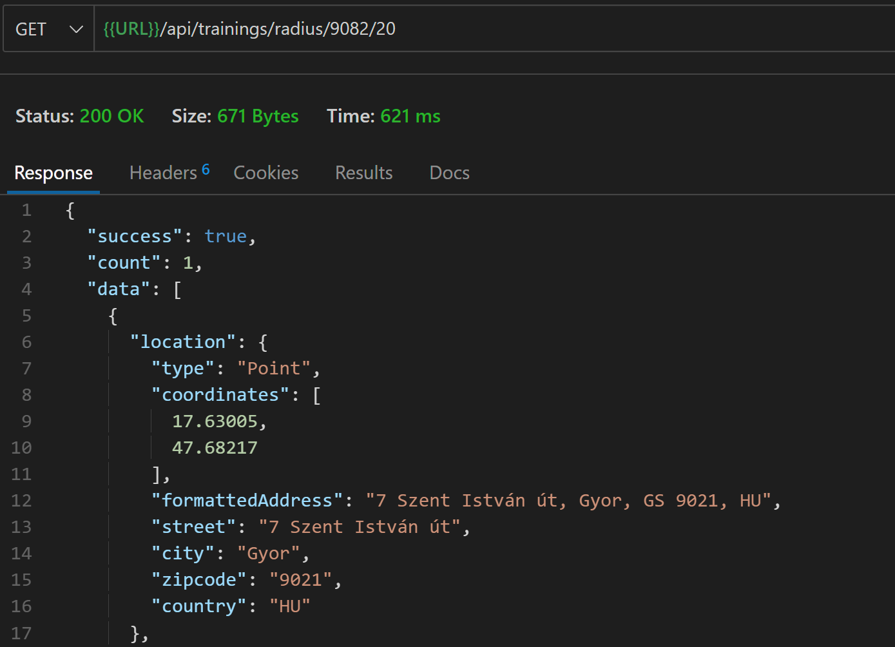
Földrajzi lekérdezések
Egy adott irányítószám közelében lévő kurzusokat keresünk. https://www.mongodb.com/docs/manual/reference/operator/query/centerSphere/
controllers/trainings.js
const express = require("express");
const {
getTraining,
getTrainings,
createTraining,
updateTraining,
deleteTraining,
getTrainingsInRadius
} = require("../controllers/trainings");
const router = express.Router();
router.route('/radius/:zipcode/:distance').get(getTrainingsInRadius)
const geocoder = require('../utils/geocoder')
…
// @desc Get training within a radius (distance is km, radius is radian)
// @route GET /api/trainings/radius/:zipcode/:distance
// @access Private
exports.getTrainingsInRadius = async (req, res, next) => {
try {
const { zipcode, distance } = req.params;
// Get lat/lng from geocoder
loc = await geocoder.geocode(zipcode);
const lat = loc[0].latitude;
const lng = loc[0].longitude;
// Earth radius = 3963 miles / 6378 km
const radius = distance / 6378;
const trainings = await Training.find({
location: { $geoWithin: { $centerSphere: [[lng, lat], radius] } },
});
res
.status(200)
.json({ success: true, count: trainings.length, data: trainings });
} catch (error) {
res.status(400).json({ success: false });
}
};
routes/trainings.js

Slide 3
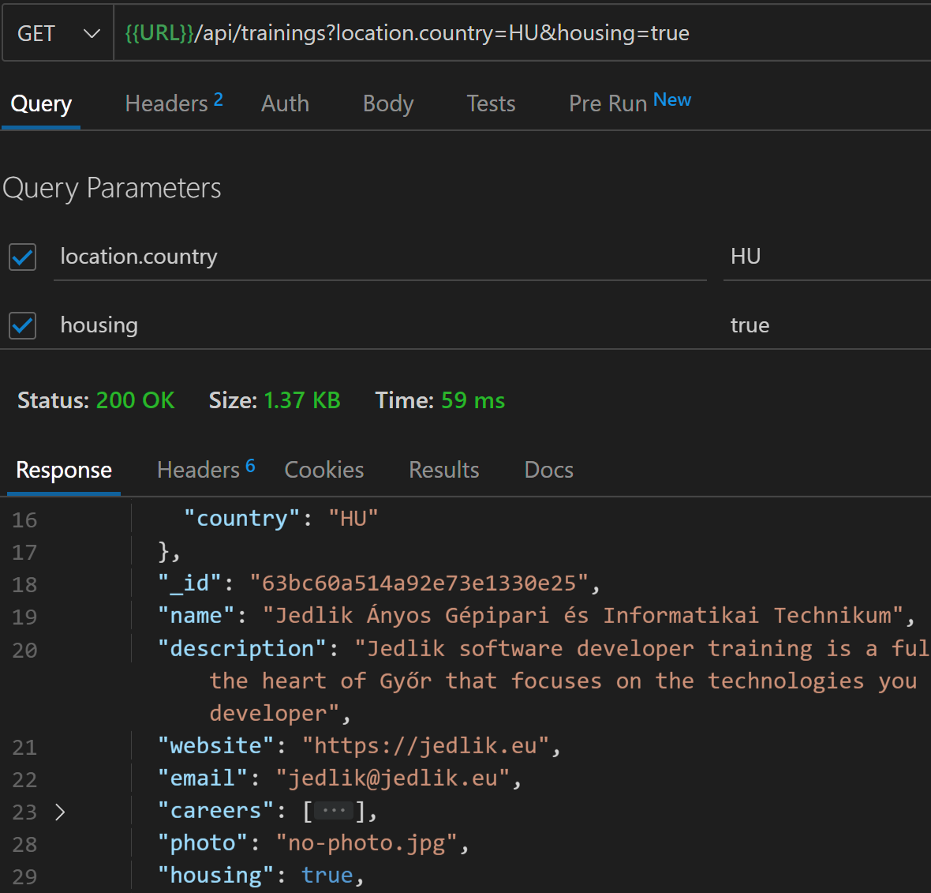
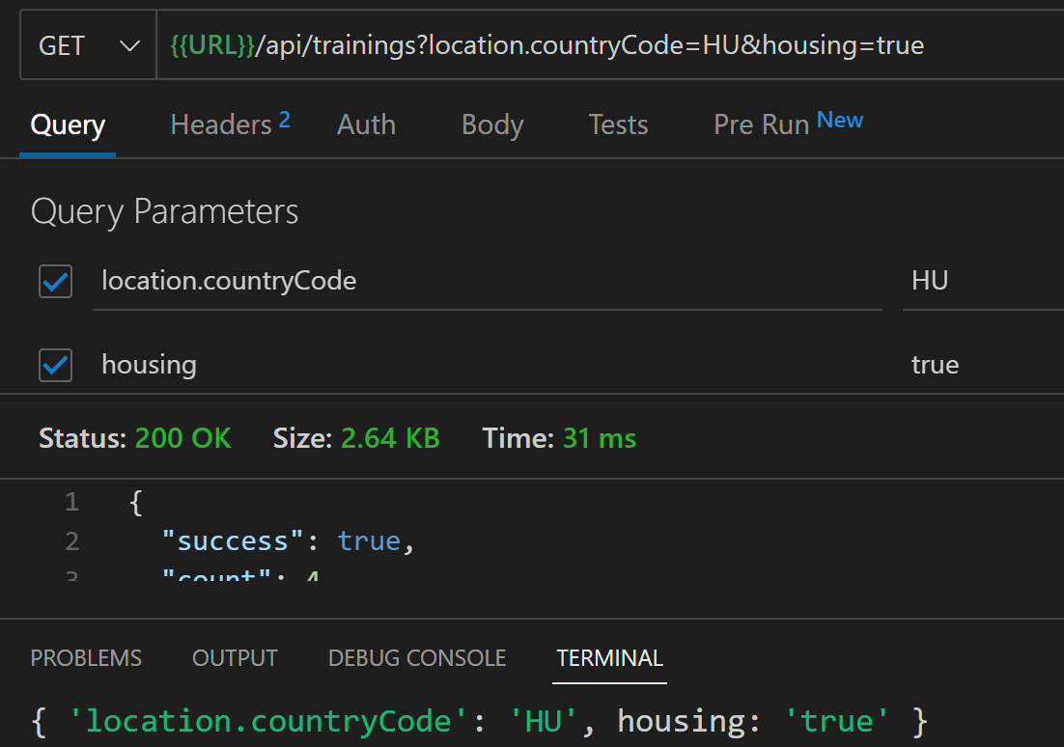
Speciális szűrés
// @desc Get all trainings
// @route GET /api/trainings
// @access Public
exports.getTrainings = async (req, res, next) => {
try {
const trainings = await Training.find(req.query);
res
.status(200)
.json({ success: true, count: trainings.length, data: trainings });
} catch (error) {
res.status(400).json({ success: false });
}
};
controllers/trainings.js
exports.getTrainings = async (req, res, next) => {
console.log(req.query)
try {…}
catch (error) {…}
};

Slide 4
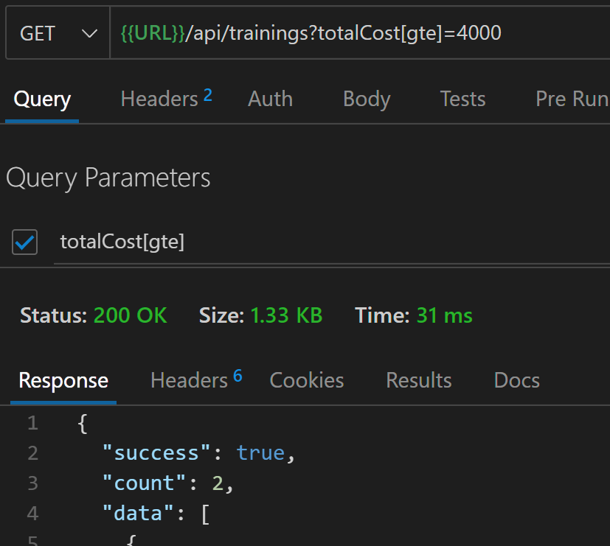
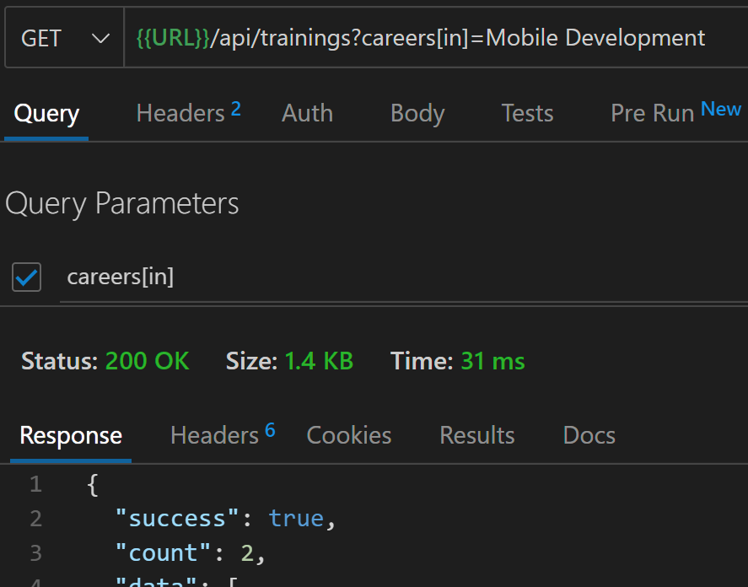
Speciális szűrés
Adjunk hozzá mindegyik dokumentumhoz kézzel egy totalCost mezőt.
Ez a mező szerepel a model-ben!!!
// @desc Get all trainings
// @route GET /api/trainings
// @access Public
exports.getTrainings = async (req, res, next) => {
try {
let query;
let queryStr = JSON.stringify(req.query)
// Kicseréljük a query-ben lévő lte sztringet $lte-re
queryStr = queryStr.replace(/\b(gt|gte|lt|lte|in)\b/g, match => `$${match}`)
query = Training.find(JSON.parse(queryStr));
const trainings = await query;

Slide 5
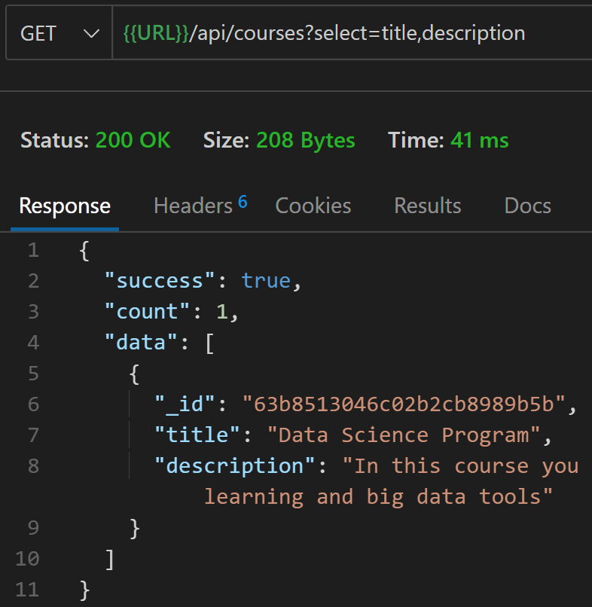
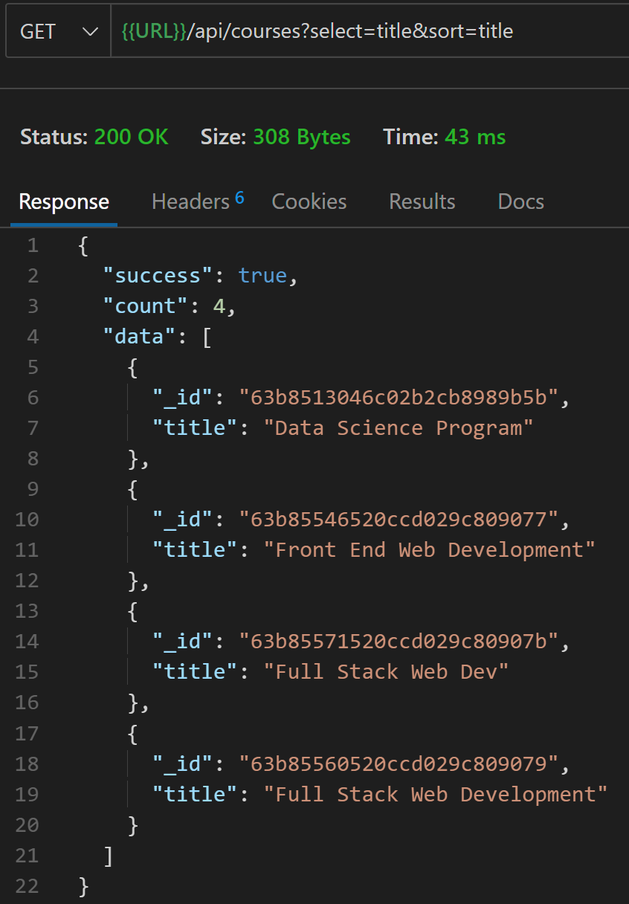
Mezők kiválasztása és rendezés
if (req.query.sort) {
const sortBy = req.query.sort.split(',').join(' ')
query = query.sort(sortBy)
} else {
query = query.sort('-createdAt') // Dátum szerint csökkenő rendezés
}
query = Course.find(JSON.parse(queryStr));
if (req.query.select) {
const fields = req.query.select.split(',').join(' ')
query = query.select(fields)
}

Slide 6
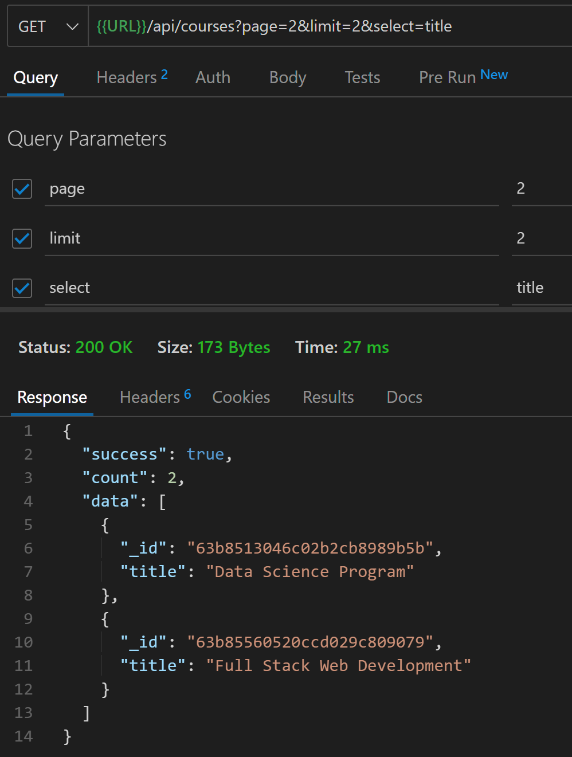
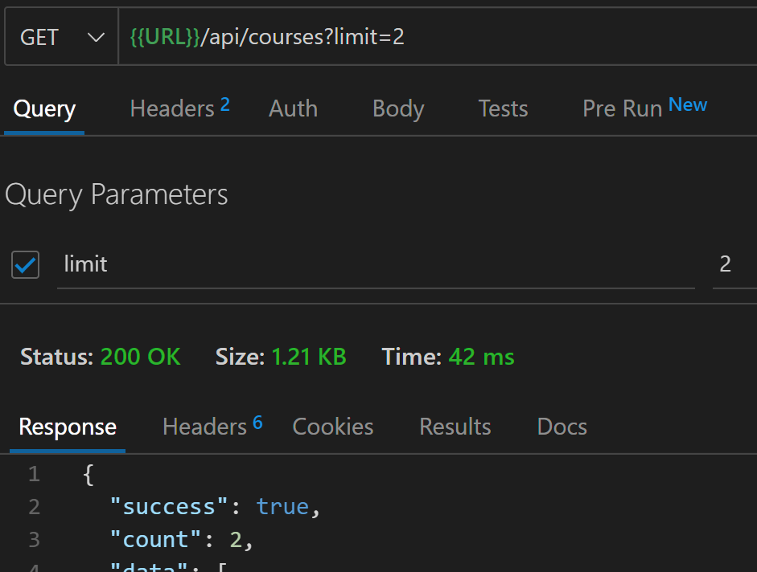
Oldalszám hozzáadása
const page = parseInt(req.query.page) || 1
const limit = parseInt(req.query.page) || 2
const startIndex = (page -1) * limit
query = query.skip(startIndex).limit(limit)

Slide 7
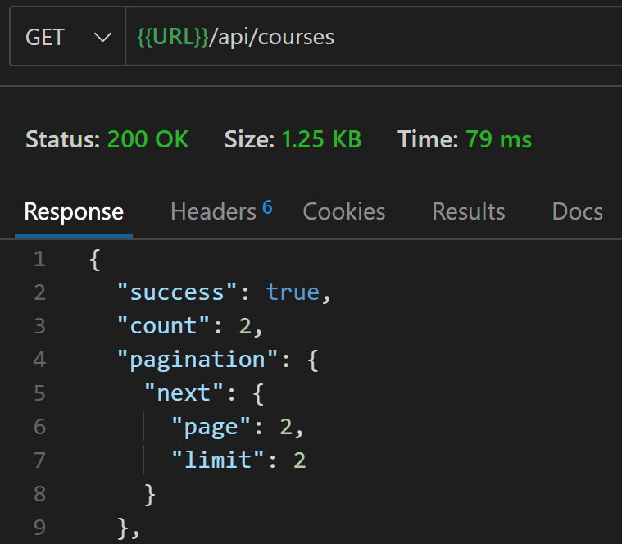
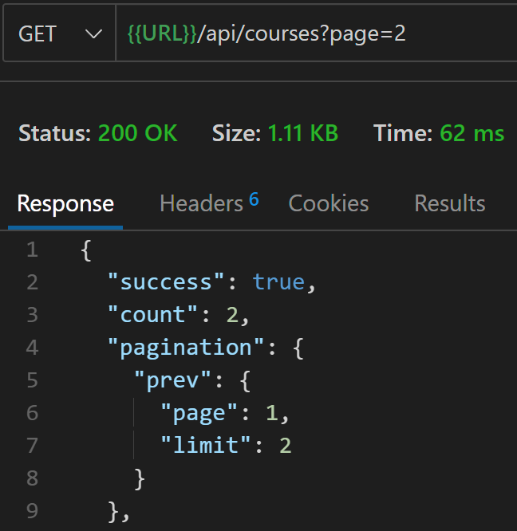
Oldalszám hozzáadása
query = query.skip(startIndex).limit(limit);
const pagination = {};
if (startIndex > 0) {
pagination.prev = {
page: page - 1,
limit,
};
}
if (endIndex < total) {
pagination.next = {
page: page + 1,
limit,
};
}
const courses = await query;
res
.status(200)
.json({
success: true,
count: courses.length,
pagination,
data: courses,
});
Összesen 4 dokumentum van feltöltve az adatbázisba

Slide 8
Kapcsolatok kezelése
const mongoose = require("mongoose");
const CourseSchema = new mongoose.Schema({
title: {
type: String,
trim: true,
required: [true, 'Please add a course title']
},
description: {
type: String,
required: [true, 'Please add a description']
},
weeks: {
type: String,
required: [true, 'Please add a number of weeks']
},
price: {
type: Number,
default: 0.0
},
minimumSkill: {
type: String,
required: [true, 'Please add a minimum skill'],
enum: ['beginner', 'intermediate', 'advanced']
},
createdAt: {
type: Date,
default: Date.now
},
training: {
type: mongoose.Schema.ObjectId,
ref: 'Training',
required: true
}
})
module.exports = mongoose.model("Course", CourseSchema, "courses");
Importáljuk be a Compass segítségével a courses.json fájlt.

Slide 9
Kurzusok útválasztása és kontrollerei (összes kurzus)
controllers/courses.js
const geocoder = require("../utils/geocoder");
const Course = require("../models/Course");
const ErrorResponse = require("../utils/errorResponse");
// @desc Get courses
// @route GET /api/courses
// @route GET /api/trainings/:trainingId/courses
// @access Public
exports.getCourses = async (req, res, next) => {
try {
let query
if (req.params.trainingId) {
query = Course.find({ training: req.params.trainingId })
} else {
query = Course.find()
}
const courses = await query
if (courses.length === 0) {
return res
.status(404)
.json({ success: false, msg: `Not found ${req.params.trainingId} id` })
}
res
.status(200)
.json({ success: true, count: courses.length, data: courses })
} catch (error) {
next(error)
}
}
routes/courses.js
const express = require("express");
const {getCourses} = require("../controllers/courses");
const router = express.Router();
router.route('/').get(getCourses)
module.exports = router;
Ezt a metódust két különböző útvonalon
akarjuk használni
server.js
const trainings = require('./routes/trainings')
const courses = require('./routes/courses')
… app.use("/api/trainings", trainings);
app.use("/api/courses", courses);
Teszteljük a /api/courses útvonalat!

Slide 10
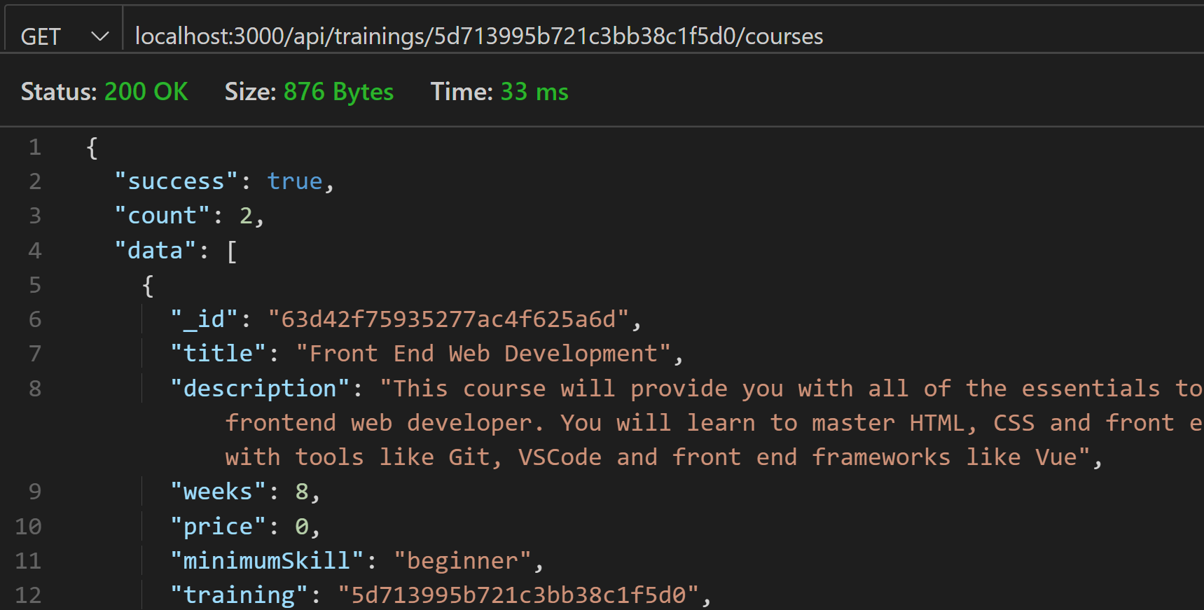
Kurzusok útválasztása és kontrollerei (adott képzés kurzusai)
Adott képzés kurzusainak lekérdezése:
localhost:3000/api/trainings/5d713995b721c3bb38c1f5d0/courses
routes/courses.js
const express = require("express");
const {getCourses} = require("../controllers/courses");
const router = express.Router({ mergeParams: true});
router.route('/').get(getCourses)
module.exports = router;
routes/trainings.js
const express = require("express");
const {
getTraining,
getTrainings,
createTraining,
updateTraining,
deleteTraining,
getTrainingsInRadius
} = require("../controllers/trainings");
const courseRouter = require('./courses')
const router = express.Router();
router.use('/:trainingId/courses', courseRouter)
Notes:
Lehet, hogy szükséges a routes/courses.js-be:
const router = express.Router({ mergeParams: true });

Slide 11
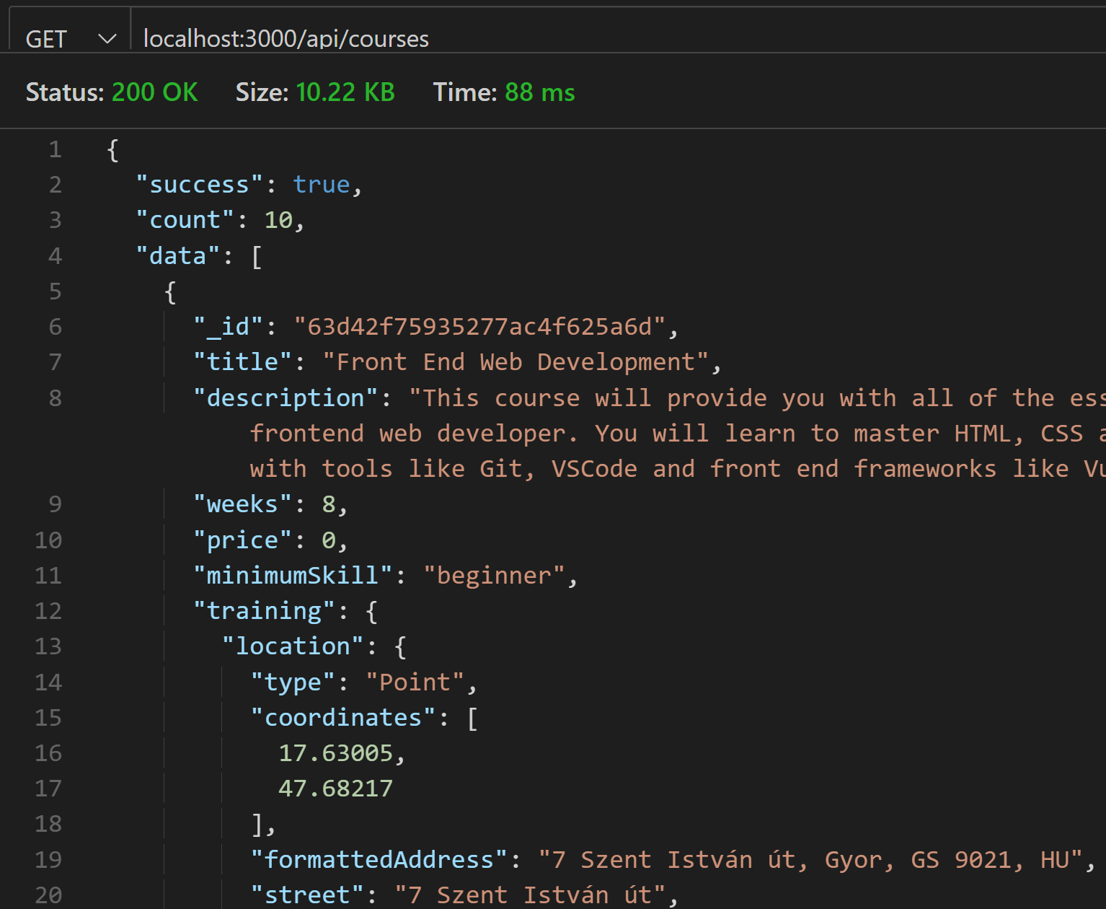
Populate
controllers/courses.js
const geocoder = require("../utils/geocoder");
const Course = require("../models/Course");
const ErrorResponse = require("../utils/errorResponse");
// @desc Get courses
// @route GET /api/courses
// @route GET /api/trainings/:trainingId/courses
// @access Public
exports.getCourses = async (req, res, next) => {
try {
let query
if (req.params.trainingId) {
query = Course.find({ training: req.params.trainingId })
} else {
query = Course.find().populate('training')
}
const courses = await query
if (courses.length === 0) {
return res
.status(404)
.json({ success: false, msg: `Not found ${req.params.trainingId} id` })
}
res
.status(200)
.json({ success: true, count: courses.length, data: courses })
} catch (error) {
next(error)
}
}
Minden kurzushoz lekérjük a képzés adatait is, amelyhez az adott kurzus tartozik

Slide 12
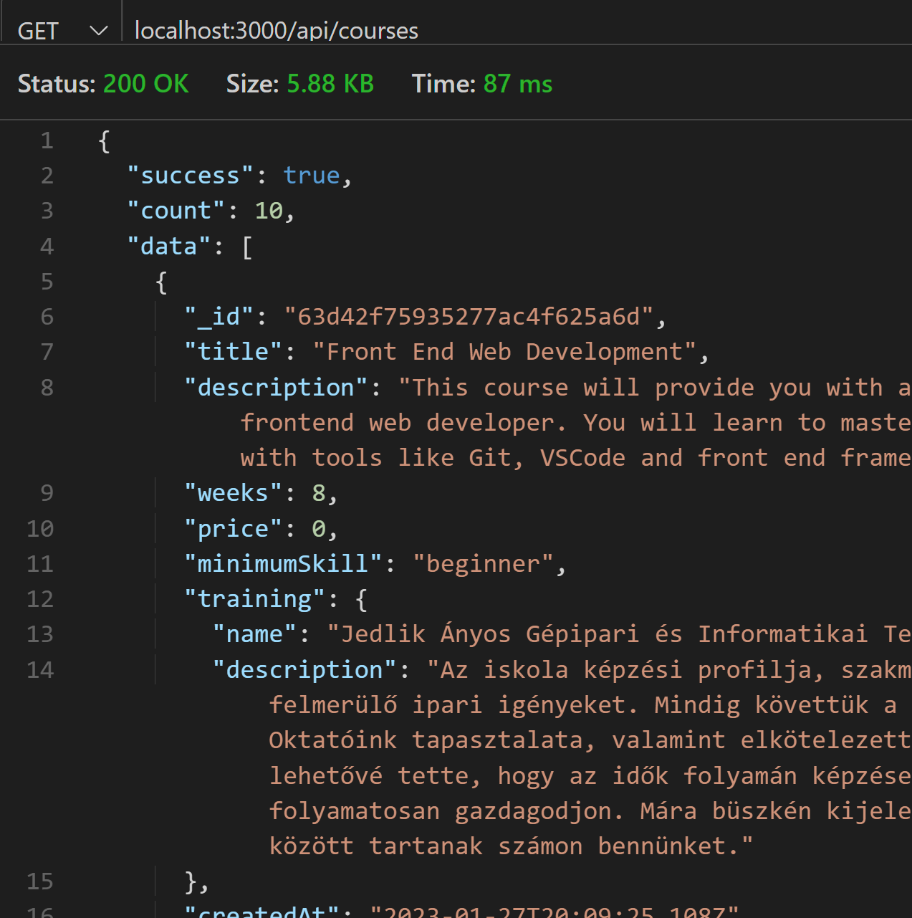
Populate
controllers/courses.js
exports.getCourses = async (req, res, next) => {
try {
let query
if (req.params.trainingId) {
query = Course.find({ training: req.params.trainingId })
} else {
query = Course.find().populate({
path: 'training',
select: '-_id name description'
})
}
…

Slide 13
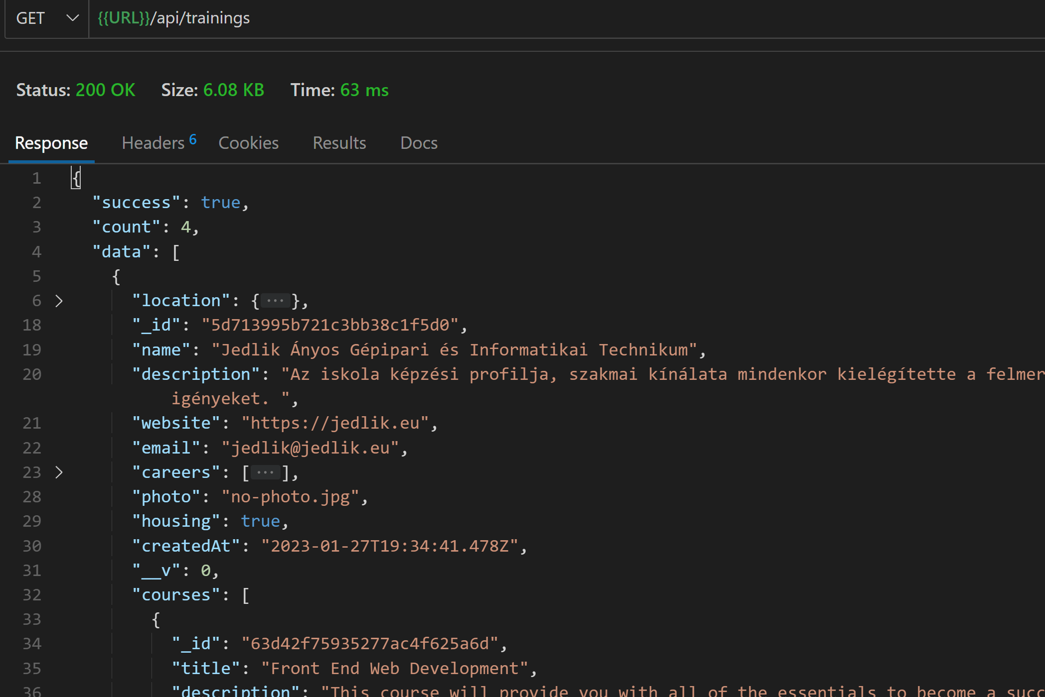
Virtual
controllers/trainings.js
exports.getTrainings = async (req, res, next) => {
try {
let query;
let queryStr = JSON.stringify(req.query);
// Kicseréljük a query-ben lévő lte sztringet $lte-re
queryStr = queryStr.replace(/\b(gt|gte|lt|lte|in)\b/g, (match) => `$${match}`);
query = Training.find(JSON.parse(queryStr)).populate('courses');
const trainings = await query;
res
.status(200)
.json({ success: true, count: trainings.length, data: trainings });
} catch (error) {
res.status(400).json({ success: false });
}
};
models/Training.js
…
default: false,
},
createdAt: {
type: Date,
default: Date.now,
},
}, {
toJSON: {virtuals: true},
toObject: {virtuals: true}
});
…
})
// Reverse populate with virtuals
TrainingSchema.virtual('courses', {
ref: 'Course',
localField: '_id',
foreignField: 'training',
justOne: false
})
module.exports = mongoose.model("Training", TrainingSchema, "trainings");
Minden képzéshez lekérjük a hozzátartozó kurzusok adatait is
Notes:
Most szeretnénk megkapni az összes képzést és bennük a hozzájuk tartozó kurzusokat., tehát a fordított irányú hozzárendelést.

Slide 14
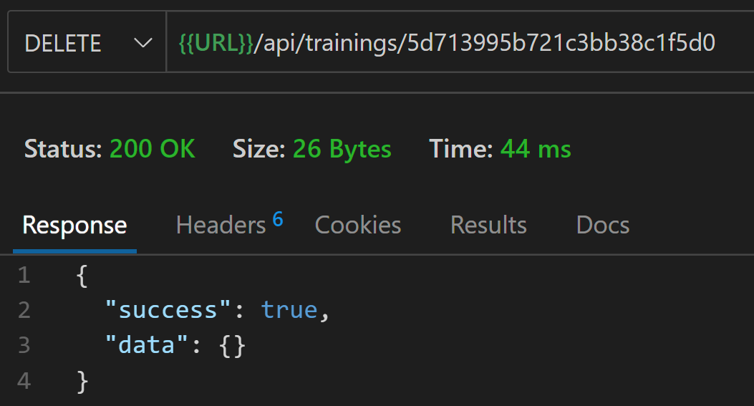
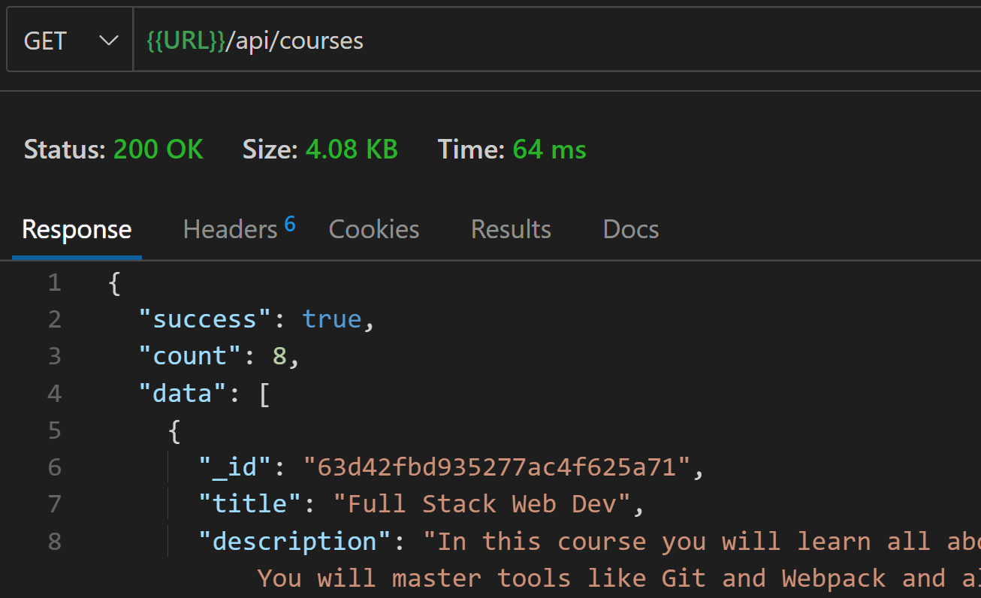
Kaszkádolt törlés
models/Training.js
// Kaszkádolt törlés, ha egy képzést törlünk, akkor az ahhoz tartozó kurzusok is törlődjenek
TrainingSchema.pre('remove', async function(next) {
console.log(`Courses being removed from bootcamp ${this._id}`);
await this.model('Course').deleteMany({ training: this._id})
next()
})
controllers/trainings.js
exports.deleteTraining = async (req, res, next) => {
try {
const training = await Training.findById(req.params.id);
if (!training) {
return res.status(400).json({ success: false, msg: "Not found" });
}
training.remove()
res.status(200).json({ success: true, data: {} });
} catch (error) {
res.status(400).json({ success: false });
}
};
Kettővel kevesebb lett!
Notes:
Ha törlünk egy képzést, akkor az ahhoz tartozó összes kurzus is törlődjön.

Slide 15
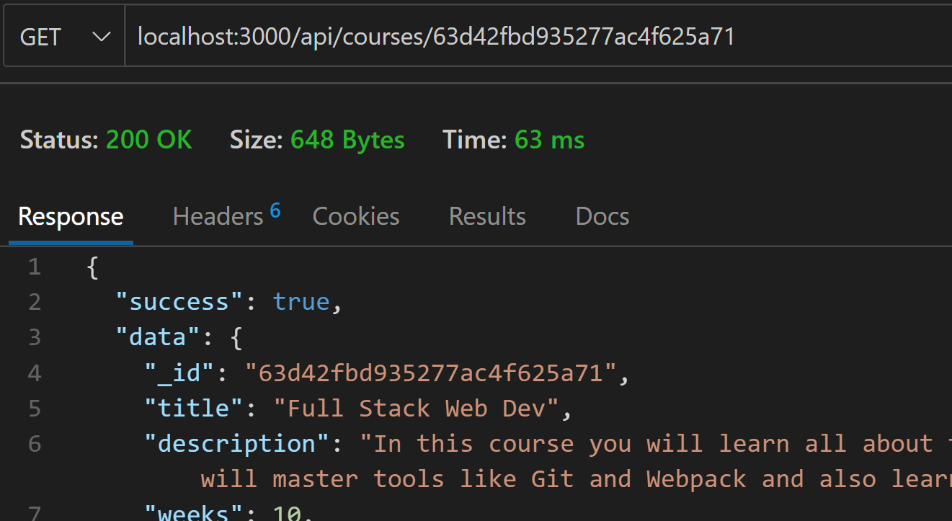
Adott kurzus lekérése
controllers/courses.js
routes/courses.js
// @desc Get single course
// @route GET /api/courses/:id
// @access Public
exports.getCourse = async (req, res, next) => {
try {
const course = await Course.findById(req.params.id).populate({
path: 'training',
select: 'name description'
})
if (!course) {
return next(new ErrorResponse(`No course with the id of ${req.params.id}`, 404))
}
res.status(200).json({ success: true, data: course })
} catch (error) {
next(error)
}
}
const express = require("express");
const {getCourses, getCourse} = require("../controllers/courses");
const router = express.Router({ mergeParams: true });
router.route('/').get(getCourses)
router.route('/:id').get(getCourse)
module.exports = router;

Slide 16
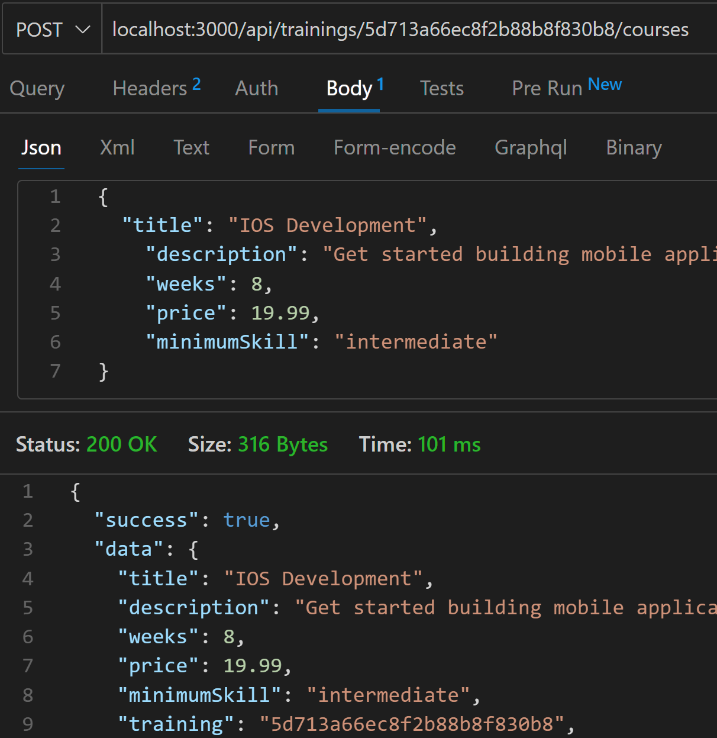
Új kurzus felvétele
routes/courses.js
const express = require("express");
const {getCourses, getCourse, addCourse} = require("../controllers/courses");
const router = express.Router({ mergeParams: true });
router.route('/').get(getCourses).post(addCourse)
router.route('/:id').get(getCourse)
module.exports = router;
controllers/courses.js
// @desc Add course
// @route POST /api/trainings/:trainingId/courses
// @access Private
exports.addCourse = async (req, res, next) => {
try {
req.body.training = req.params.trainingId
const training = await Training.findById(req.params.trainingId)
if (!training) {
return next(new ErrorResponse(`No training with the id of ${req.params.trainingId}`, 404))
}
const course = await Course.create(req.body)
res.status(200).json({ success: true, data: course })
} catch (error) {
next(error)
}
}
Mivel a routes/trainings.js-ben már be van állítva az erőforrás megosztás!
const courseRouter = require('./courses')
…
router.use('/:trainingId/courses', courseRouter)
Notes:
Új kurzus felvételéhez szükségünk van egy képzés azonosítóra, hogy tudjuk melyik képzéshez fog tartozni a felvitt kurzus.

Slide 17
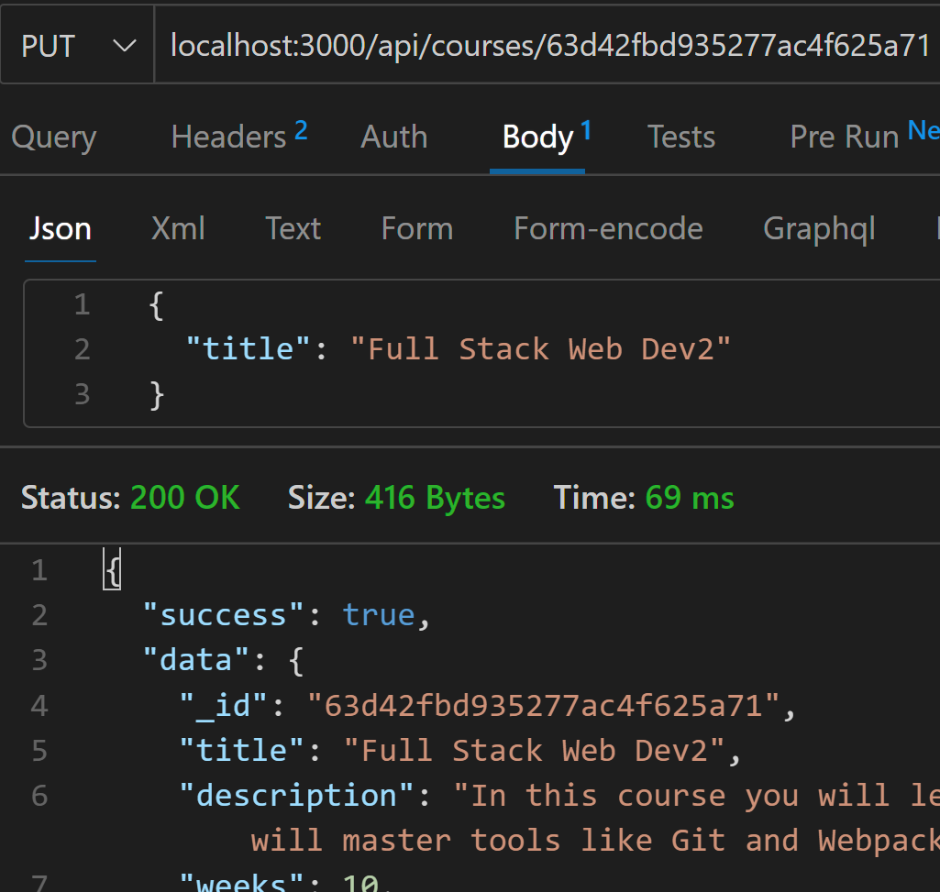
Kurzus frissítése
controllers/courses.js
// @desc Update course
// @route PUT /api/courses/:id
// @access Private
exports.updateCourse = async (req, res, next) => {
try {
let course = await Course.findById(req.params.id)
if (!course) {
return next(new ErrorResponse(`No course with the id of ${req.params.id}`, 404))
}
course = await Course.findByIdAndUpdate(req.params.id, req.body, {
new: true,
runValidators: true
})
res.status(200).json({ success: true, data: course })
} catch (error) {
next(error)
}
}
routes/courses.js
const express = require("express");
const {getCourses, getCourse, addCourse, updateCourse } = require("../controllers/courses");
const router = express.Router({ mergeParams: true });
router.route('/').get(getCourses).post(addCourse)
router.route('/:id').get(getCourse).put(updateCourse)
module.exports = router;

Slide 18
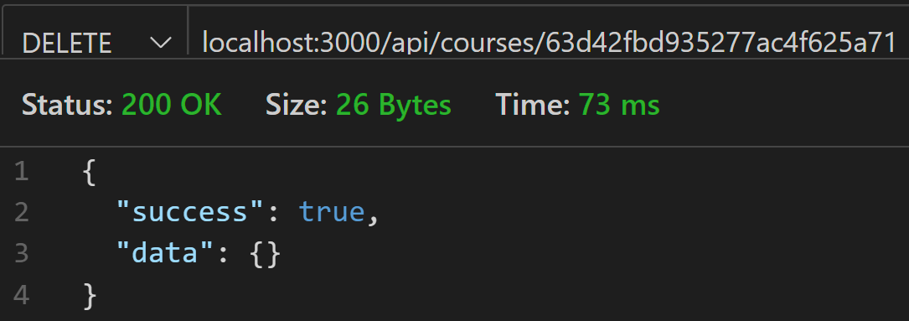
Kurzus törlése
controllers/courses.js
// @desc Delete course
// @route DELETE /api/courses/:id
// @access Private
exports.deleteCourse = async (req, res, next) => {
try {
const course = await Course.findById(req.params.id)
if (!course) {
return next(new ErrorResponse(`No course with the id of ${req.params.id}`, 404))
}
await course.remove()
res.status(200).json({ success: true, data: {} })
} catch (error) {
next(error)
}
}
routes/courses.js
const express = require("express");
const {getCourses, getCourse, addCourse, updateCourse, deleteCourse } = require("../controllers/courses");
const router = express.Router({ mergeParams: true });
router.route('/').get(getCourses).post(addCourse)
router.route('/:id').get(getCourse).put(updateCourse).delete(deleteCourse)
module.exports = router;

Slide 19
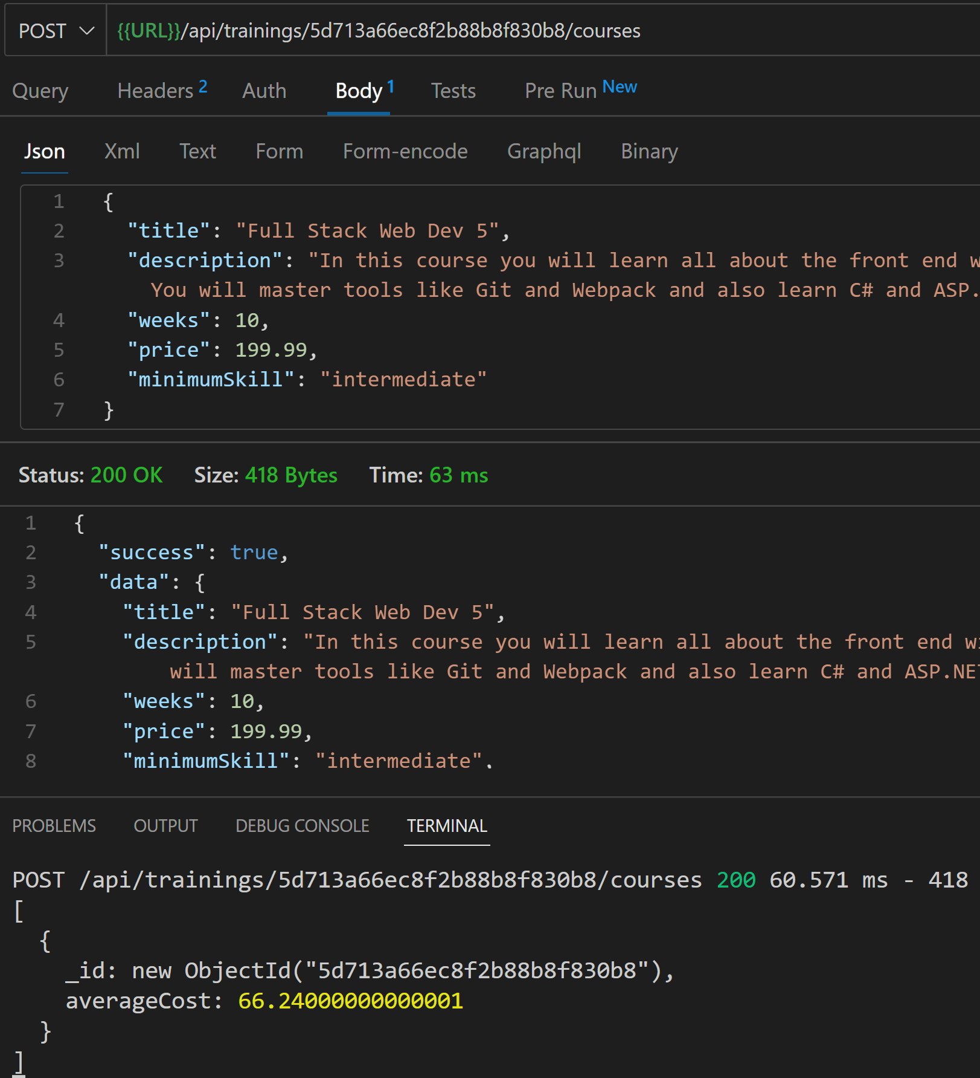
Aggregálás - Átlag tandíj kiszámítása
models/Course.js
// Statikus metódus az adott képzéshez tartozó kurzusok
// átlagos költségének kiszámítására
CourseSchema.statics.getAverageCost = async function(trainingId) {
const obj = await this.aggregate([
{
$match: { training: trainingId }
},
{
$group: {
_id: '$training',
averageCost: { $avg: '$price' }
}
}
])
console.log(obj);
}
// A getAverageCost hívása a mentés(create) után
CourseSchema.post('save', function() {
this.constructor.getAverageCost(this.training)
})
// A getAverageCost hívása a remove(delete) előtt
CourseSchema.pre('remove', function() {
this.constructor.getAverageCost(this.training)
})
module.exports = mongoose.model("Course", CourseSchema, "courses");

Slide 20
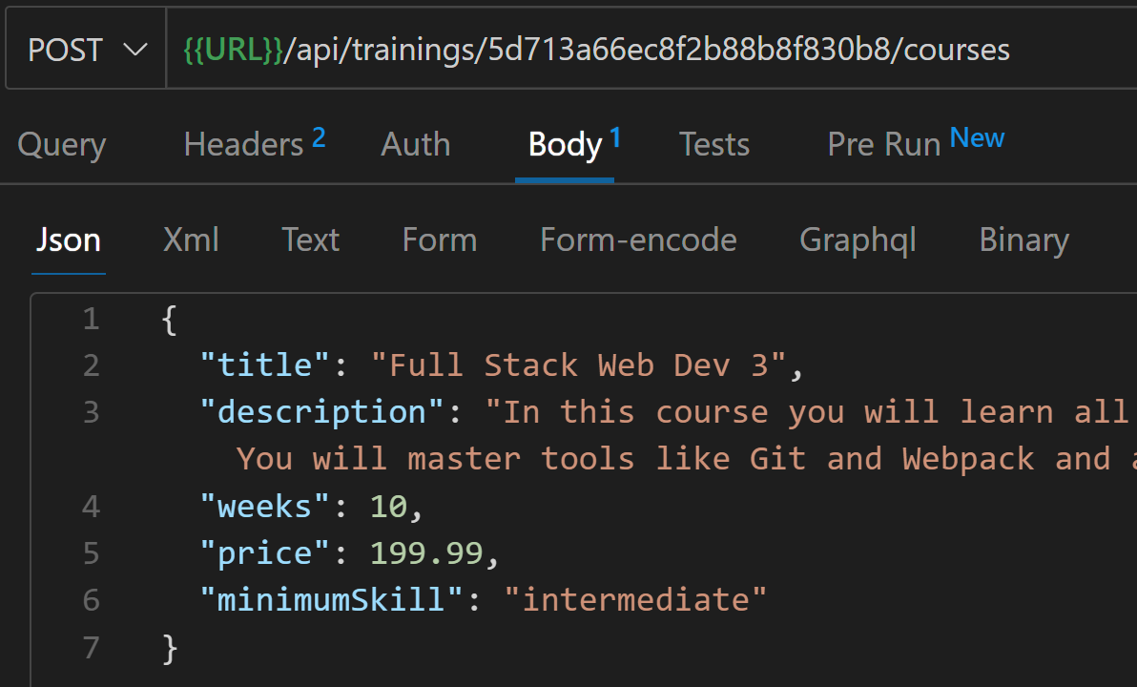
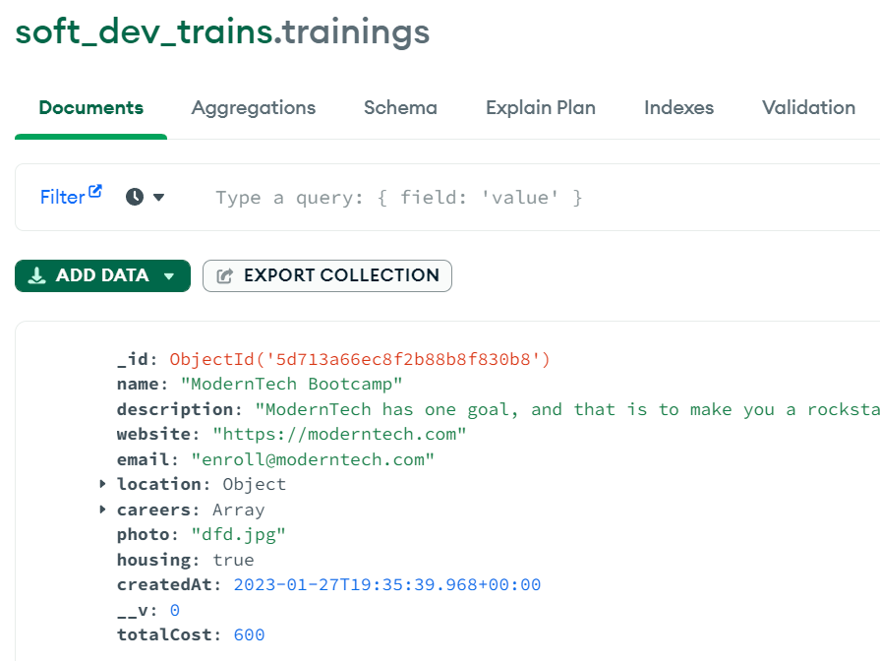
Aggregálás - Teljes tandíj kiszámítása
models/Training.js
averageRating: {
type: Number,
min: [1, "Rating must be at least 1"],
max: [10, "Rating must can not be more than 10"],
},
totalCost: Number,
photo: {
type: String,
default: "no-photo.jpg",
},
models/Course.js
// Statikus metódus az adott képzéshez tartozó kurzusok átlagos költségének kiszámítására
CourseSchema.statics.getAverageCost = async function(trainingId) {
const obj = await this.aggregate([
{
$match: { training: trainingId }
},
{
$group: {
_id: '$training',
averageCost: { $sum: '$price' }
}
}
])
try {
await this.model('Training').findByIdAndUpdate(trainingId, {
totalCost: Math.ceil(obj[0].averageCost / 10)*10
})
} catch (error) {
console.error(error);
}
}
Így már az adatbázisban is el lesz tárolva az átlagos költsége az adott képzésnek

Slide 21
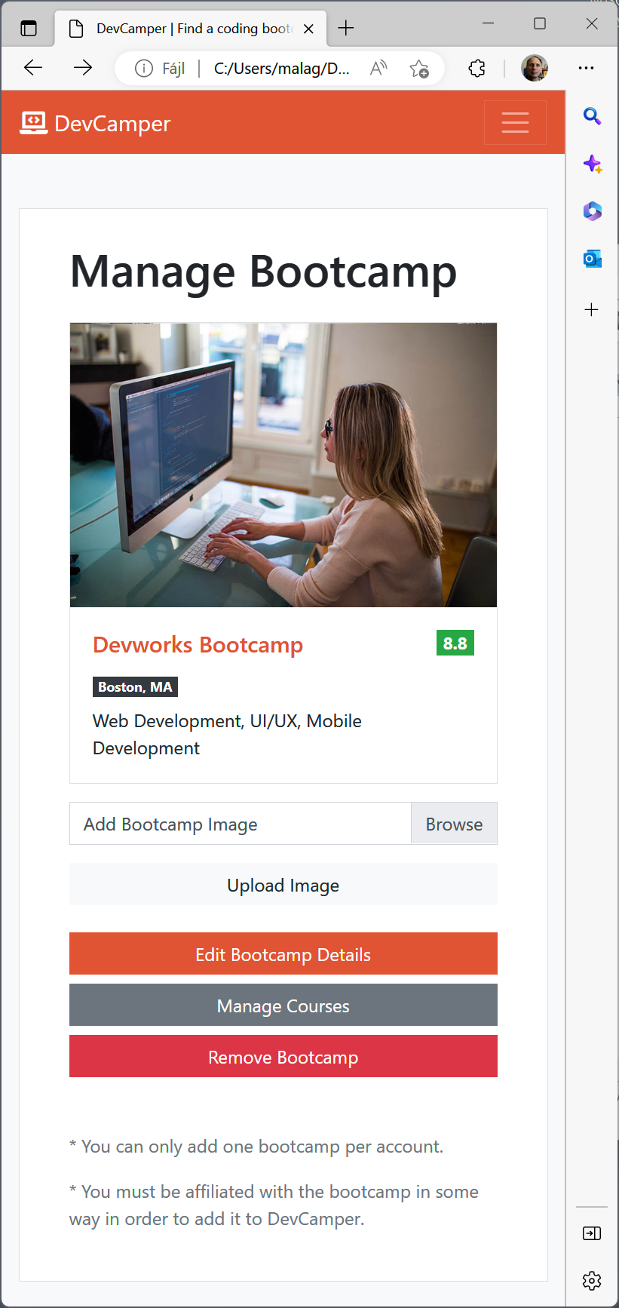
Fotó feltöltése
server.js
const fileupload = require('express-fileupload')
…
app.use(express.json())
app.use(morgan('dev'))
app.use(fileupload())
app.use("/api/trainings", trainings);
app.use("/api/courses", courses);
Az express-fileupload nevű csomagot
fogjuk használni a fájlfeltöltéshez.
https://www.npmjs.com/package/express-fileupload
npm i express-fileupload
routes/trainings.js
const express = require("express");
const {
getTraining,
getTrainings,
createTraining,
updateTraining,
deleteTraining,
getTrainingsInRadius,
trainingPhotoUpload
} = require("../controllers/trainings");
const courseRouter = require('./courses')
const router = express.Router();
router.use('/:trainingId/courses', courseRouter)
router.route('/radius/:zipcode/:distance').get(getTrainingsInRadius)
router.route('/:id/photo').put(trainingPhotoUpload)
router.route("/").get(getTrainings).post(createTraining);

Slide 22
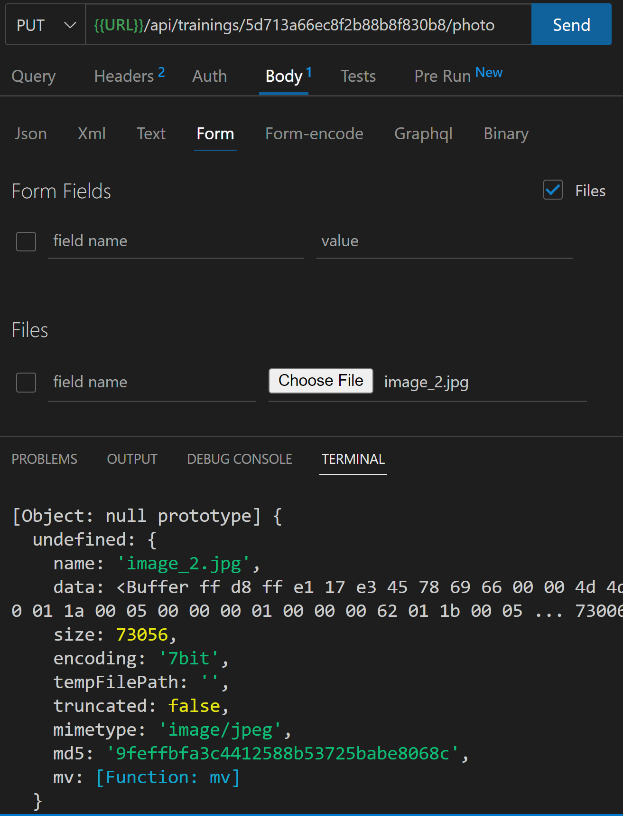
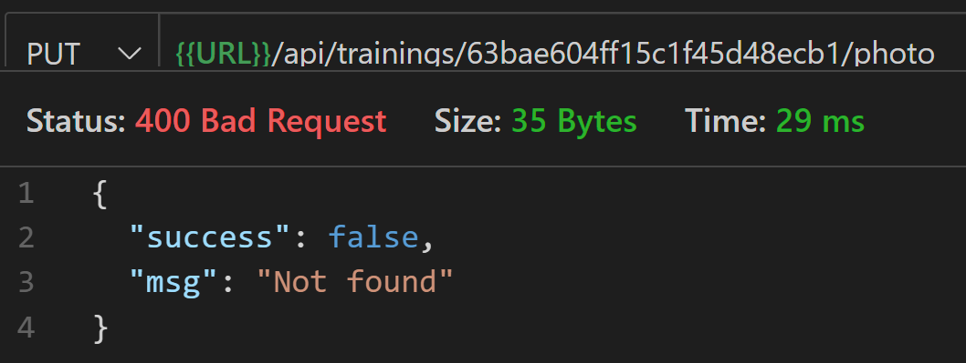

Fotó feltöltése
controllers/trainings.js
exports.trainingPhotoUpload = async (req, res, next) => {
try {
console.log(req.params.id);
const training = await Training.findById(req.params.id);
if (!training) {
return res.status(400).json({ success: false, msg: "Not found" });
}
if (!req.files) {
return res.status(400).json({ success: false, msg: "Please upload a file" });
}
console.log(req.files);
} catch (error) {
res.status(400).json({ success: false });
}
}
A file áthelyezéséhez való fgv.

Slide 23
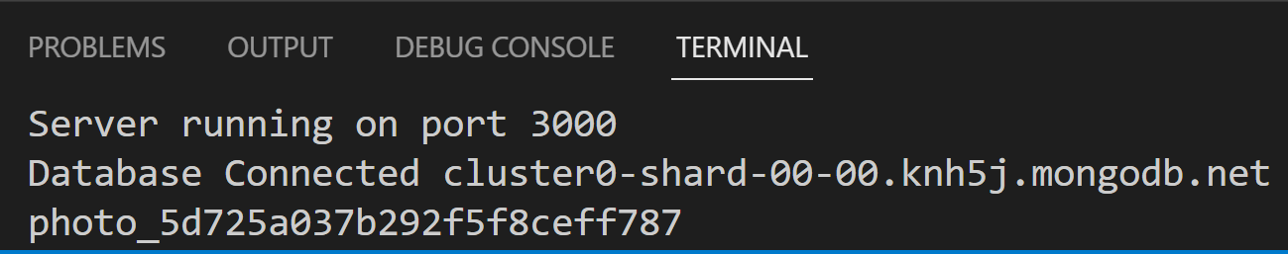
Fotó feltöltése
.env
controllers/trainings.js
PORT=3000
DATABASE_URL = mongodb+srv://…
GEOCODER_PROVIDER = mapquest
GEOCODER_API_KEY = 8e7TfHK8zGpC3LeCECzxIc58YmGfeFR1
FILE_UPLOAD_PATH = ./public/uploads
MAX_FILE_UPLOAD = 1000000
exports.trainingPhotoUpload = async (req, res, next) => {
try {
console.log(req.params.id);
const training = await Training.findById(req.params.id);
if (!training) {
return res.status(400).json({ success: false, msg: "Not found" });
}
if (!req.files) {
return res.status(400).json({ success: false, msg: "Please upload a file" });
}
const file = req.files.file
if (!file.mimetype.startsWith('image')) {
return res.status(400).json({ success: false, msg: "Please upload an image file" });
}
if (file.size > process.env.MAX_FILE_UPLOAD) {
return res.status(400).json({ success: false, msg: `Please upload an image less than ${process.env.MAX_FILE_UPLOAD}` });
}
file.name = `photo_${training.id}`
console.log(file.name);
} catch (error) {
res.status(400).json({ success: false });
}
}
Nincs benne a kiterjesztés!

Slide 24
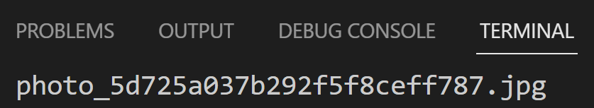
Fotó feltöltése
controllers/trainings.js
const path = require('path')
…
exports.trainingPhotoUpload = async (req, res, next) => {
try {
console.log(req.params.id);
const training = await Training.findById(req.params.id);
if (!training) {
return res.status(400).json({ success: false, msg: "Not found" });
}
if (!req.files) {
return res.status(400).json({ success: false, msg: "Please upload a file" });
}
const file = req.files.file
if (!file.mimetype.startsWith('image')) {
return res.status(400).json({ success: false, msg: "Please upload an image file" });
}
if (file.size > process.env.MAX_FILE_UPLOAD) {
return res.status(400).json({ success: false, msg: `Please upload an image less than ${process.env.MAX_FILE_UPLOAD}` });
}
file.name = `photo_${training.id}${path.parse(file.name).ext}`
console.log(file.name);
} catch (error) {
res.status(400).json({ success: false });
}
}

Slide 25
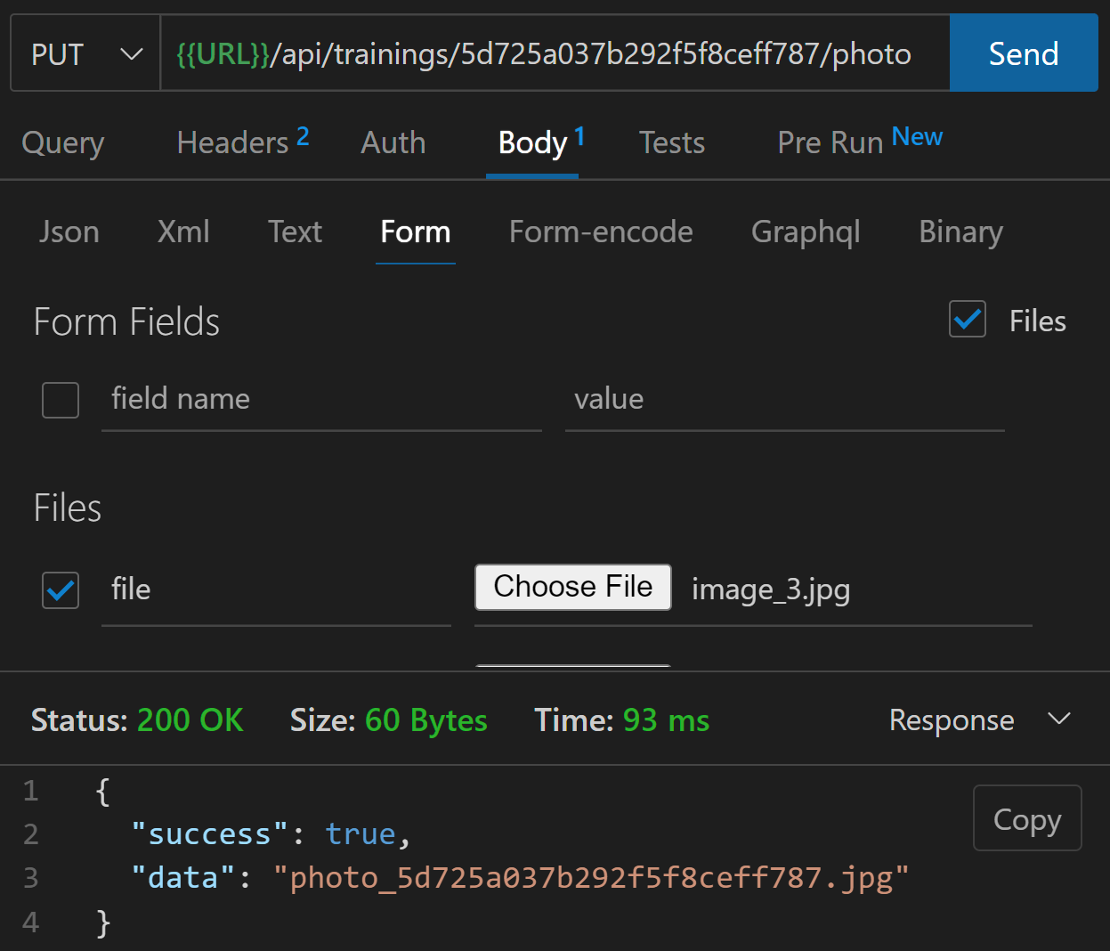
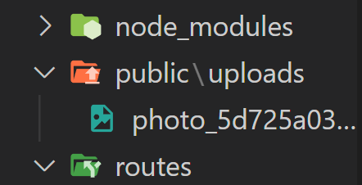
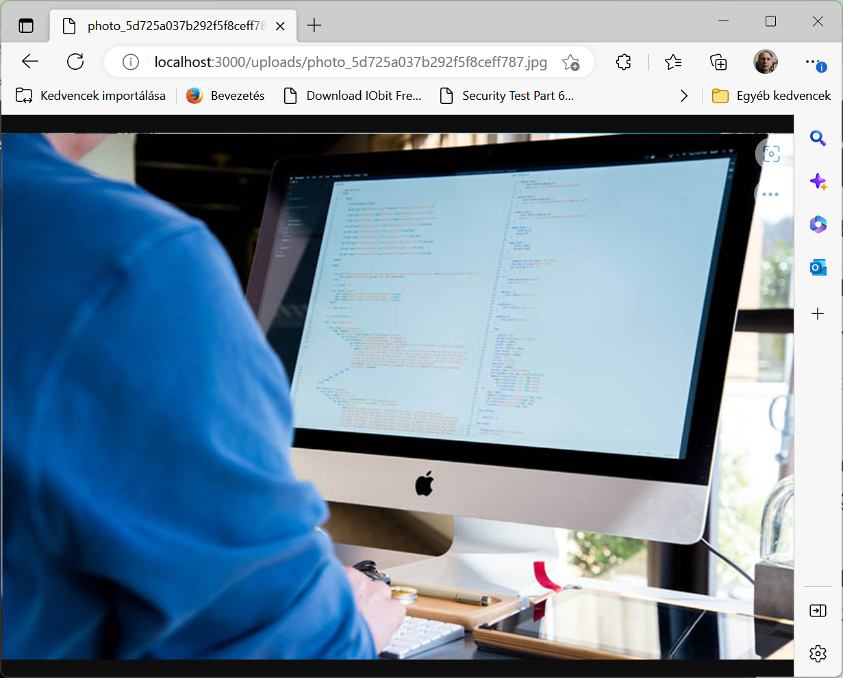
Fotó feltöltése
Hozzunk létre a public mappát, benne pedig egy uploads mappát.
server.js
const path = require('path')
…
app.use(fileUpload())
app.use(express.static(path.join(__dirname, 'public')))
controllers/trainings.js
…
file.name = `photo_${training.id}${path.parse(file.name).ext}`
file.mv(`${process.env.FILE_UPLOAD_PATH}/${file.name}`, async err => {
if (err) {
console.error(err);
return res.status(500).json({ success: false, msg: `Problem with file upload` });
}
})
await Training.findByIdAndUpdate(req.params.id, { photo: file.name })
res.status(200).json({
success: true,
data: file.name
})
} catch (error) {
res.status(400).json({ success: false });
}

Slide 26
Lekérdezés támogató middleware
Hozzunk létre egy új fájlt advancedResults.js néven a middleware mappában.
if (populate) {
query = query.populate(populate);
console.log(query);
}
// Executing query
const results = await query;
// Pagination result
const pagination = {};
if (endIndex < total) {
pagination.next = {
page: page + 1,
limit
};
}
if (startIndex > 0) {
pagination.prev = {
page: page - 1,
limit
};
}
res.advancedResults = {
success: true,
count: results.length,
pagination,
data: results
};
next();
}
module.exports = advancedResult
const advancedResult = (model, populate) => async (req, res, next) => {
let query;
// Copy req.query
const reqQuery = { ...req.query };
// Fields to exclude
const removeFields = ['select', 'sort', 'page', 'limit'];
// Loop over removeFields and delete them from reqQuery
removeFields.forEach(param => delete reqQuery[param]);
// Create query string
let queryStr = JSON.stringify(reqQuery);
// Create operators ($gt, $gte, etc)
queryStr = queryStr.replace(/\b(gt|gte|lt|lte|in)\b/g, match => `$${match}`);
// Finding resource
query = model.find(JSON.parse(queryStr));
// Select Fields
if (req.query.select) {
const fields = req.query.select.split(',').join(' ');
query = query.select(fields);
}
// Sort
if (req.query.sort) {
const sortBy = req.query.sort.split(',').join(' ');
query = query.sort(sortBy);
} else {
query = query.sort('-createdAt');
}
// Pagination
const page = parseInt(req.query.page, 10) || 1;
const limit = parseInt(req.query.limit, 10) || 25;
const startIndex = (page - 1) * limit;
const endIndex = page * limit;
const total = await model.countDocuments();
query = query.skip(startIndex).limit(limit);
Notes:
Szeretnénk, ha a már megírt szűrés, lapozás, rendezés mindenhol elérhető legyen!

Slide 27
Lekérdezés támogató middleware
/controllers/trainings.js
/routes/training.js
// @desc Get all trainings
// @route GET /api/trainings
// @access Public
exports.getTrainings = async (req, res, next) => {
try {
res
.status(200)
.json(res.advancedResults);
} catch (error) {
res.status(400).json({ success: false });
}
};
const advancedResults = require('../middleware/advancedResults')
const courseRouter = require('./courses');
const Training = require("../models/Training");
const router = express.Router();
…
router.route("/")
.get(advancedResults(Training, 'courses'), getTrainings)
.post(createTraining);
/controllers/courses.js
exports.getCourses = async (req, res, next) => {
try {
if (req.params.trainingId) {
const courses = await Course.find({ training: req.params.trainingId })
return res.status(200).json({
success: true,
count: courses.length,
data: courses
})
} else {
res.status(200).json(res.advancedResults)
}
} catch (error) {
next(error)
}
}
/routes/courses.js
const Course = require('../models/Course')
const advancedResults = require('../middleware/advancedResults')
const router = express.Router({ mergeParams: true });
router.route('/').get(advancedResults(Course, {
path: 'training',
select: 'name description'
}), getCourses).post(addCourse)
Notes:
Szeretnénk, ha a már megírt szűrés, lapozás, rendezés mindenhol elérhető legyen!

